Slide 1
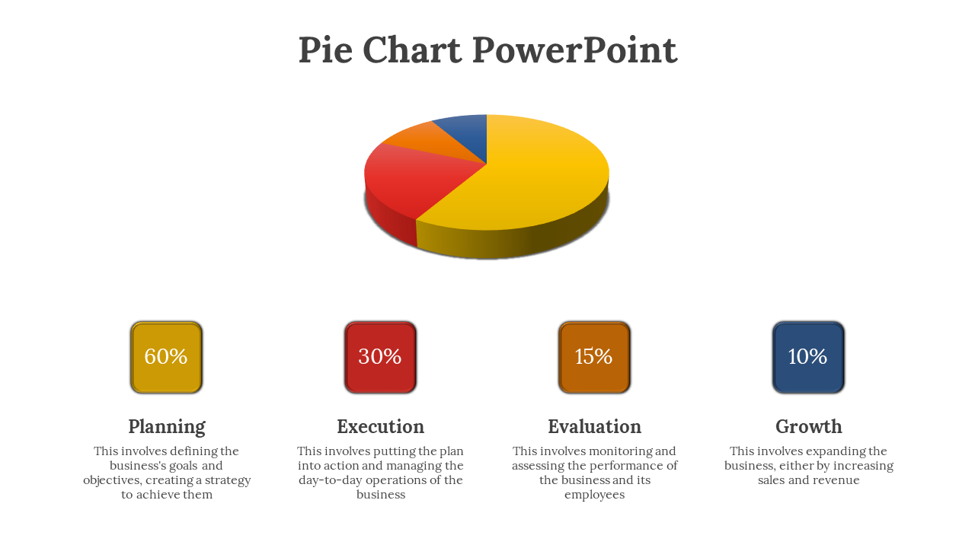
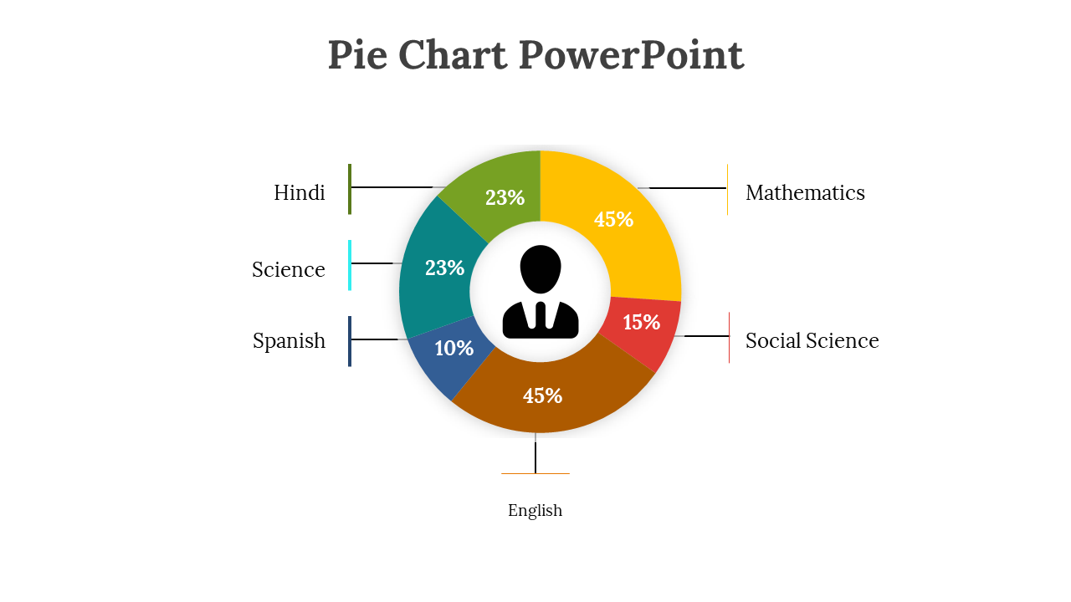
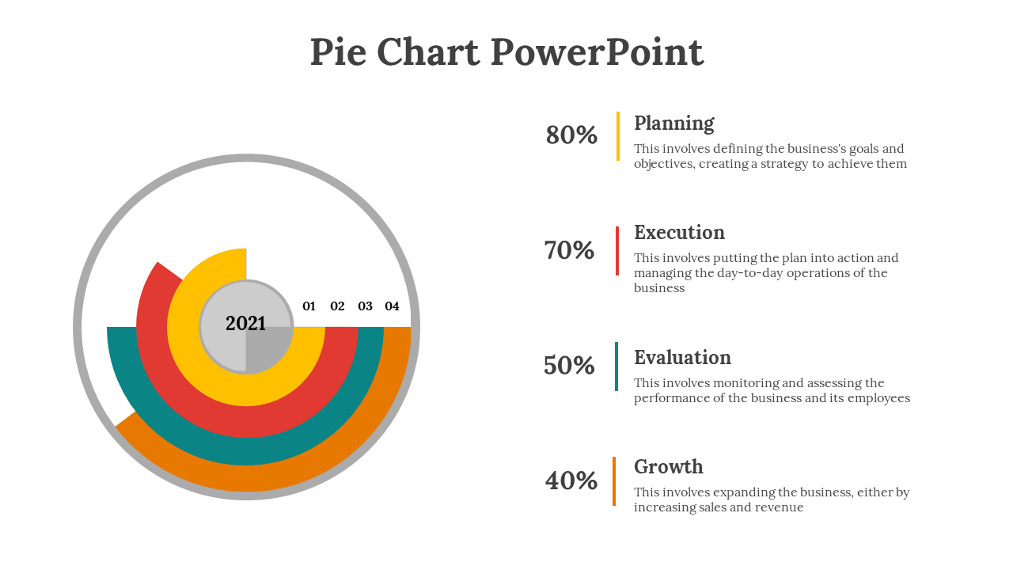
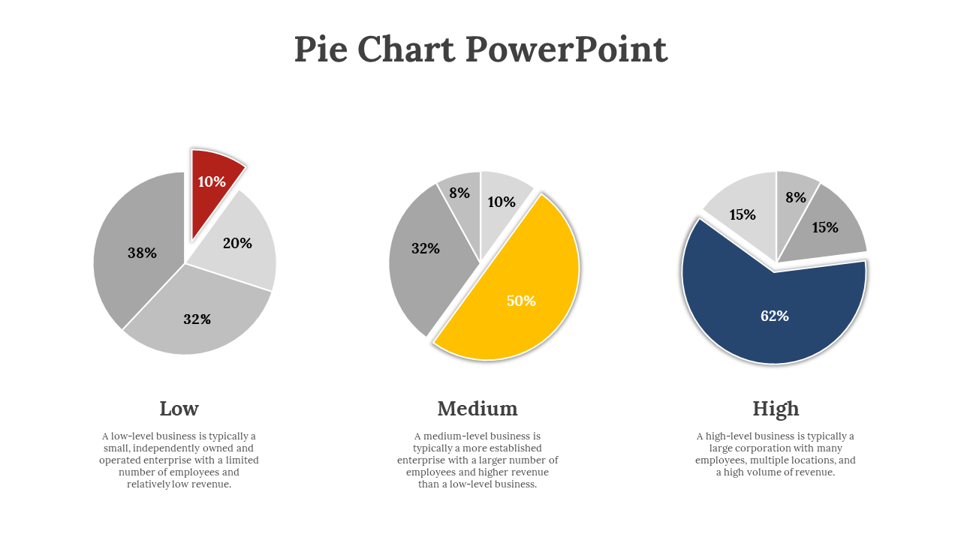
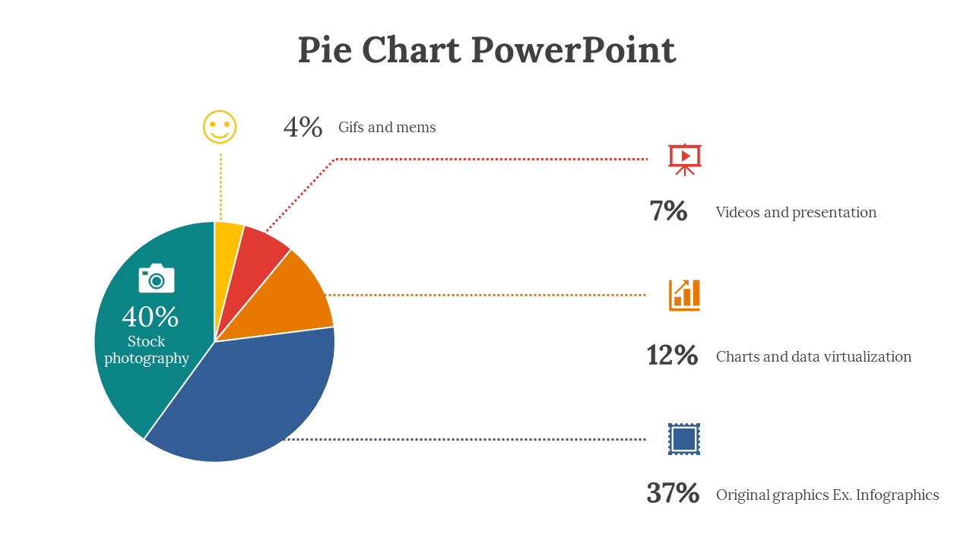
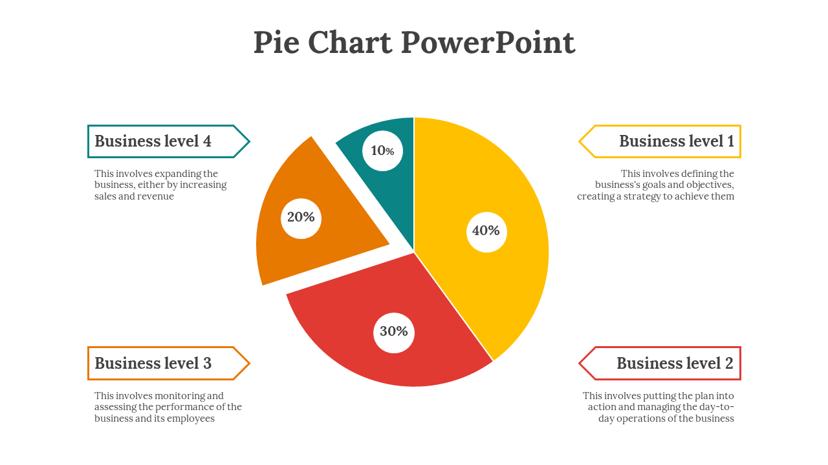
Pie Chart PowerPoint

Slide 2





4%
Gifs and mems
7%
Videos and presentation
40%
Stock photography
12%
Charts and data virtualization
37%
Original graphics Ex. Infographics

Slide 3
Business level 4
Business level 1
10%
This involves expanding the business, either by increasing sales and revenue
This involves defining the business's goals and objectives, creating a strategy to achieve them
20%
40%
30%
Business level 3
Business level 2
This involves monitoring and assessing the performance of the business and its employees
This involves putting the plan into action and managing the day-to-day operations of the business

Slide 4
Low
Medium
High
A low-level business is typically a small, independently owned and operated enterprise with a limited number of employees and relatively low revenue.
A medium-level business is typically a more established enterprise with a larger number of employees and higher revenue than a low-level business.
A high-level business is typically a large corporation with many employees, multiple locations, and a high volume of revenue.

Slide 5
60%
30%
15%
10%
Planning
This involves defining the business's goals and objectives, creating a strategy to achieve them
Execution
This involves putting the plan into action and managing the day-to-day operations of the business
Evaluation
This involves monitoring and assessing the performance of the business and its employees
Growth
This involves expanding the business, either by increasing sales and revenue

Slide 6

Hindi
23%
Mathematics
45%
Science
23%
15%
Spanish
10%
Social Science
45%
English

Slide 7
80%
Planning
This involves defining the business's goals and objectives, creating a strategy to achieve them
Execution
This involves putting the plan into action and managing the day-to-day operations of the business
70%
01
02
03
04
2021
50%
Evaluation
This involves monitoring and assessing the performance of the business and its employees
Growth
This involves expanding the business, either by increasing sales and revenue
40%

Slide 8
Icons

Slide 9
Icons

Slide 10
How To Edit Shapes
You can add and edit some shapes to your presentation to present your data in a visual way.
Choose your favourite infographic and insert it in your presentation using Ctrl C + Ctrl V or Cmd C + Cmd V in Mac.
Select one of the parts and ungroup it by right-clicking and choosing “Ungroup”.
Change the color by clicking on the paint bucket.
Then resize the element by clicking and dragging one of the square-shaped points of its bounding box (the cursor should look like a double-headed arrow). Remember to hold Shift while dragging to keep the proportions.
Group the elements again by selecting them, right-clicking and choosing “Group”.
Repeat the steps above with the other parts and when you’re done editing, copy the end result and paste it into your presentation.
Remember to choose the “Keep source formatting” option so that it keeps the design. For more info, please visit Slideegg (Tips & Tricks).

Slide 11
Terms Of Use (Free Users)
If you are a free subscriber, you should credit SlideEgg by keeping the “Thank You” slide.
Kindly refer to the following slide for the Terms of Use for premium users.
You can:
Customize or edit this template
Use this template for both business and personal endeavors.
You can not:
Sell, rent, or second-license SlideEgg content or its altered version. Promulgate, unless explicitly permitted, SlideEgg content, by SlideEgg.
Incorporate SlideEgg content in any database or file online or offline.
Obtain SlideEgg content’s copyright.
Kindly refer to our Tutorial page or FAQ for advanced slide modification guidelines.

Slide 12
Terms Of Use (Premium Users)
Being a premium subscriber, you have the privilege of using this PPT template
without giving attribution to SlideEgg or keeping the “Thank You” slide.
You can:
Customize or edit this template.
Use this template for both business and personal endeavors.
Circulate or share the editable format of this template with anyone you want.
You can not:
Sell, rent or second-license SlideEgg content or the altered version of it. Promulgate or include the templates in any other services database
that performs as distribution or resale platform, unless explicitly permitted, by SlideEgg.
Incorporate the elements used in SlideEgg’s templates separately.
Obtain SlideEgg’s copyright for the elements used in this template as a logo or trademark.
Kindly refer to our Tutorial page or FAQ for advanced slide modification guidelines.

Slide 13





Thank You!
We respect your valuable time with SlideEgg!
If you have any questions, please reach us
Do you have a design request, please visit our redesign page.
CREDIT: SlideEgg created this PowerPoint template.
Let this slide be kept for attribution.
www.slideegg.com

